Slide 1
Static Memory Systems Design
  68k Read and Write Bus cycles
    68k Timing Diagrams, Min/Max Parameters etc.
    Data Exchange Protocols: Dtack Timing, Wait States.
  Design of Simple, Flexible DTACK* Generator Circuit.
  Analysis of 68000 and Static Ram Timings.
    Interfacing to Asynchronous and Synchronous Sram
  ARM-9 Programmable External Memory Interface
©Paul Davies. Not to be copied, used, or revised without explicit written permission from the copyright owner.
This lecture may contain animations and is best viewed as a slide show

Slide 2
68000 Asynchronous Bus interface
The 68k as we know uses an asynchronous bus interface, the basics of which are:-
  The 68000 outputs an address: A1-A23.
  Address Strobe (AS) is asserted.
  R/W indicates direction of data transfer.
  UDS and LDS indicate the width of data transfer.
  Data transferred over D0-D7, D8-D15
  Memory confirms transfer by asserting DTACK
  When 68000 receives the DTACK it terminates the bus cycle by negating AS, R/W, UDS and LDS and removing the address.
Bus Error (BERR) is asserted for non-responding memory (i.e. illegal address).
Advantages/Disadvantages
Main advantage of an asynchronous memory protocol is that it allows the CPU to interface with both fast and slow memories at whatever speed they are able to communicate (they just provide the DTACK* when they are ready).
Main disadvantage is that the need for handshaking (via DTACK) limits overall data transfer rate in highest speed systems e.g. bursting data (e.g. cache fills – our 68k does not yet have a cache so this is not a problem).
68000
Address
Buffers
Address
Decoder
A1 – A23
D0 – D15
Data
Bus
Buffers
AS
R/W
CS
CS
Mem
Chip
Mem
Chip
UDS
LDS
CS
CS
Mem
Chip
Mem
Chip
DTACK
BERR
Memory
Sub-System
Generated for non-responding memory

Slide 3
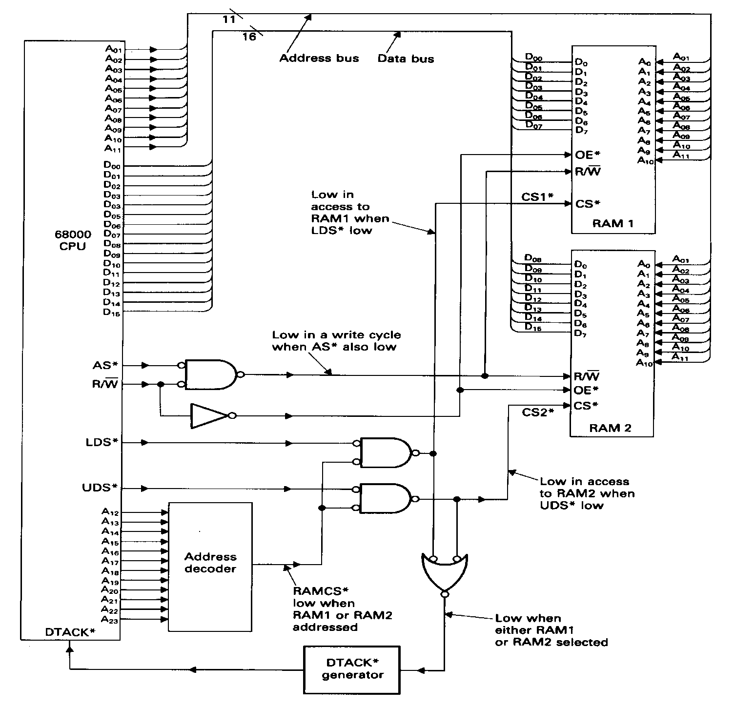
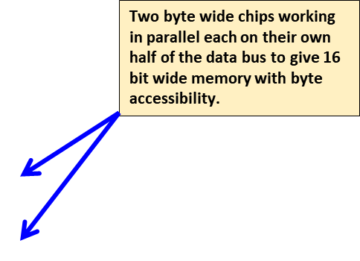
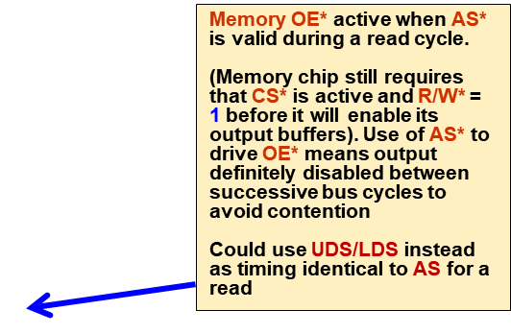
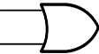
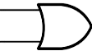
Typical Interface for a 68000 to Asynchronous SRam, e.g. 2k x 16
2k x 8
Address Bus
Data Bus
Lower byte memory CS* active when LDS* = 0 and
Ram_Select_L = 0.
2k x 8
Memory write ‘enabled’ when R/W = 0. Gating this with AS* is added insurance against false writes but not essential.
IMPORTANT study for rest of lecture
Upper byte memory CS* active when UDS* = 0 and
Ram_Select_L = 0.
BERR*
Ram_Select_L from address decoder
Signal to Dtack* generator indicates that memory is selected, triggering Dtack generator back to 68k
CLK for timing purposes

Slide 4
Original 68k
Read
Bus Cycle Timing
Notes:
Probably the MOST important thing we study as a H/W engineer learning about a new processor is the Bus Cycle Timing.
All processor data sheets will have a chapter on this as it describes in great detail the protocol and timing of the signals involved in transferring data between processor and memory.
Designing memory systems to be compatible with your CPU starts right here
Some CPUs (like the 68k) use an Asynchronous transfer protocol which requires a handshake, others may be Synchronous which do not need handshaking and data is expected to be available ‘x’ ns after the processor asks for it
Some CPUs may also have a cache and can burst data as part of a single bus cycle, while others, without a cache, require a new bus cycle for each byte/word transferred. Our 68k fits into the latter category (for the moment).
Later on we will add a cache to our 68k and enhance the bus cycle timing to allow bursting of data during cache fills.

Slide 5
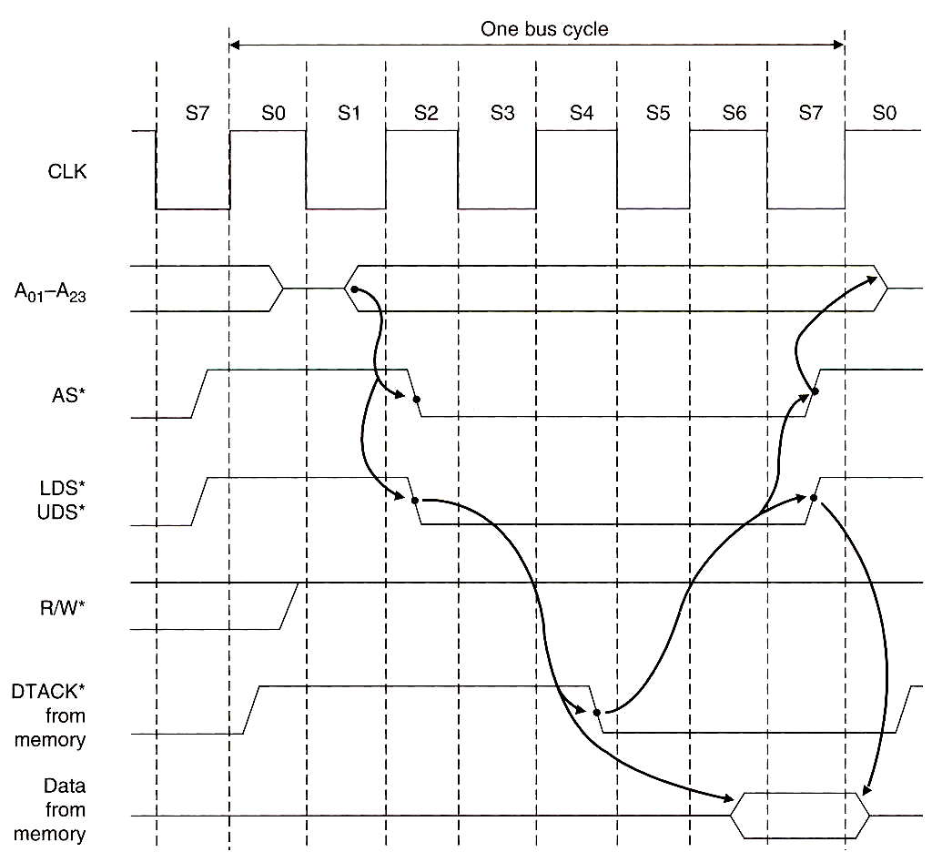
Detailed 68000 Asynchronous Read Cycle Timing Analysis
Start
One Bus Cycle = 4 clocks/8 states
End
68k Signals
Note :AS* and LDS*/UDS* are negated between bus cycles.
This means the memory CS* and OE* are also negated (see slide 3).
It also ensures bus contention between 2 different memory blocks/chips accessed in successive bus cycles is avoided because their output buffers will all be turned off between bus cycles
Notes:
Each 68k read cycle takes 4 clock cycles, comprising 8 internal states: S0-S7.
A read cycle starts with the leading edge of S0 and ends with the trailing edge of S7.
Internally, the 68000 uses a state machine to generate this timing. Different CPUs use differing numbers of states/clocks e.g. 1, 2, 4, 6, 8 etc. At the end of the day, the number of states/clocks are not important, only times. States just give us an easy way to measure that.

Slide 6
Detailed Description State S0 : Read cycle operation becomes defined
Start
Prev Address
New Read Address
Previous Address carried over into S0 from last bus cycle
Read operation defined early in S0 (before AS*, UDS*/LDS* become active) to avoid false writes
Notes:
At the start of a read cycle, all signals have been negated with the exception of the Address Bus and R/W* whose value may carry over from the previous cycle.
Address bus is tri-stated some time during S0.
AS*/UDS*/LDS* negated to deselect memory before presenting new address.
Remember, memory CS* is driven off UDS*/LDS* (See slide 3)

Slide 7
State S1 : New address output by 68k. Memory and external address decoders can start to decode address (see circuit slide 3)
Prev Address
Address Stable, decoding can commence
Notes:
S1 : A1-A23 become valid some time during state S1 and remain so into state S0 of the next cycle (after the CPU has read the data in State S7).
External address decoders can now produce a Select signal for a memory bank during S1.
The memory chips can start their internal decoding of the CPU address, regardless of the state of their CS*, R/W* or OE* signals so we can start our critical ‘access time’ analysis from here.

Slide 8
State S2 : AS* and UDS*/LDS* asserted. These provide OE* and Read signal to memory and define width of data transfer (See circuit slide 3)
Address Stable, Decoding can occur
Memory OE* and R/W* Signals defined (slide 3)
AS*, UDS*, LDS* activated
Memory CS* Signals defined by UDS*/LDS* (slide 3)
Notes:
S2 : AS* asserted and combined with R/W*=1, provide the OE* and Read signal to the memory chip (see slide 3).
UDS*/LDS* are asserted to define data width, and provide the CS* signal for the memory devices (see slide 3).
During state S2 the memory chip should have all the signals it needs to provide the data, i.e. a Stable Address, defined R/W*, CS* and OE* (see slide 3).

Slide 9
State S3 : No new signal changes here
Address Stable, Decoding can occur
Notes:
S3 : Nothing new happens. This is extra time that can be used by:
The selected memory chip to continue internally decoding the address.
The Dtack Generator to determine if the memory chip is fast enough, or whether it will be necessary to introduce wait states. See state S4.

Slide 10
State S4: Critical state for sampling DTACK*
Address Stable, Decoding can occur
DTACK* must be asserted before end of state S4 to avoid wait states
Notes:
S4 : Acknowledgement (DTACK*) from memory system sampled by 68000
Dtack Generator should assert DTACK* (based on address) before end of S4.
If DTACK* is not received by the 68k by the end of S4 then ‘wait’ states (additional, dummy [S4,S5] states will be introduced by 68k to extend the bus cycle beyond 8 states).
Note: DTACK* can be generated at any time, we do not have to wait until end of S4 to generate it.

Slide 11
States S5, S6: No new signal changes here
Address Stable, Decoding can occur
Notes:
States [S5, S6] : Nothing new happens.
This idle time gives the selected memory device more time to decode the address access the memory and provide the requested data.

Slide 12
State S7 : Data from memory latched by 68k here and 68k ends bus cycle
Stable, Decoding can occur
AS* and UDS*/LDS* removed in state S7 leading to memory CS* and OE* removed also (see slide 3)
Data Available
Available Read Access Time T_{AA}
Data MUST be available at 68k, and meet setup time before start of state S7
Memory begins to tristate its output buffers as a result of CS* and OE* being negated
Notes:
S7: Data latched internally by 68000 at start of S7.
AS* negated, turning off OE* on the Memory chips to prevent contention with other memory chips that might be accessed immediately following this bus cycle (slide 3).
UDS* and LDS* also negated, leading to the removal of CS* on memory. Data is then removed from the data bus by the memory as it tri-states its output buffers.
DTACK* is also negated (see later circuit).

Slide 13
How does original 68k timing compare with soft core version?

Slide 14
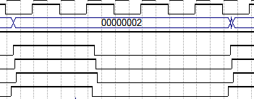
Quartus simulations of Soft Core 68k Read cycle almost identical to real 68k
Note slight difference that address does not tri-state between accesses, so new address is issued before start of S0 (which actually helps as address decoding can begin earlier).
Notice how DTACK* is asserted (in this simulation) well before end of S4 (that’s OK)
Data latched/read by 68k at start of S7 (all signals at the SRam still valid).
Address begins to change early during S7 for next access.
68k Samples Data here
Address issued early
S0
S1
S2
S3
S4
S5
S6
S7
CLK
Address
R/W*
Memory OE* and R/W* Signals defined here (Slide 3)
AS*
UDS*
Memory CS* Signals defined here by UDS*/LDS* (Slide 3)
LDS*
Dtack*
68k Samples DTACK* here

Slide 15
68k Detailed Timing Analysis
Let’s add some actual numbers to this waveform, taken from the data sheet for the original 68k and do some simple calculations regarding the available access time of the chip, to see if a particular memory chip is fast enough to be interfaced without wait states.
We will assume that no address or data buffers exist (as is the case in the circuit on slide 2 of this lecture – but were shown on slide 14 of lecture 6) and thus the propagation delays inherent in these two components can be ignored (the effect of these real delays can easily be taken into account later if required).
We also assume no propagation delays along tracks of a PCB or backplane.

Slide 16
68k Detailed Timing Analysis
Here are the important timings questions to consider during a read
  Can our memory system decode the 68k address, provide the data back to the CPU and meet the data set up time at the 68000 data pins (see next timing diagram) before start of state S7?
  Can we ensure that DTACK* is generated before the end of S4 (see DTACK* generator circuit later) ?
  Can we enable the memory’s “chip select” (CS*) signal and turn on the memory chip’s output buffer (OE*) early enough so as not to delay the data coming from the memory – generally this last point is relatively easy.
Referring back to Slide 3 we see that the memory’s OE* signal is driven off AS* (which is asserted very early in state S2 of the 68k’s bus cycle) so turning on OE* early will not be a problem.
In addition, the memory’s CS* signal is driven from the address decoder and the LDS*/UDS* signals, all of which are generated quite early in the bus cycle, so unless your external address decoder is ridiculously slow, the CS* signal will reach the memory early enough so that is does not delay the enabling of the memory or delay the data back to the CPU.

Slide 17
Timings for an 8MHz 68000

Slide 18
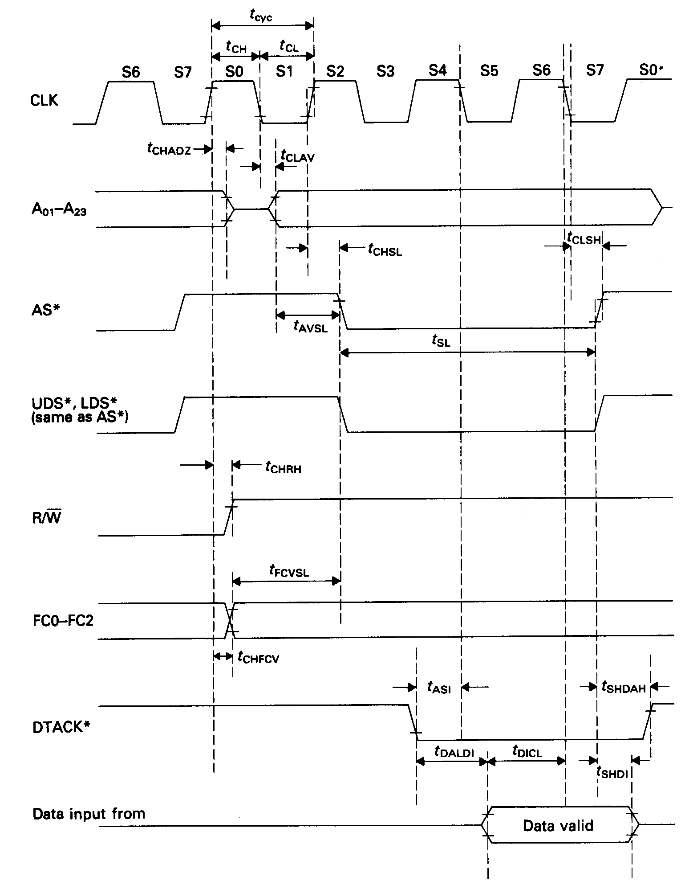
At 8MHz, Clock period t_{CYC} = 125ns
3 Clock periods = 375ns
Data latched internally by 68000 here at start of [S7]
Address becomes stable t_{CLAV} (70ns worst case) after the start of [S1]
68k min Data In Hold time t_{SHDI} relative to negation of LDS*/UDS* = 0ns
Access Time of any memory chip t_{AA} < (3 * t_{CYC}) – t_{CLAV –} t_{DICL} = 290 ns
Assuming CS* and OE* arrive in a timely fashion and do not delay data
min Data In Set-up time t_{DICL} at CPU prior to start of [S7] = 15ns

Slide 19
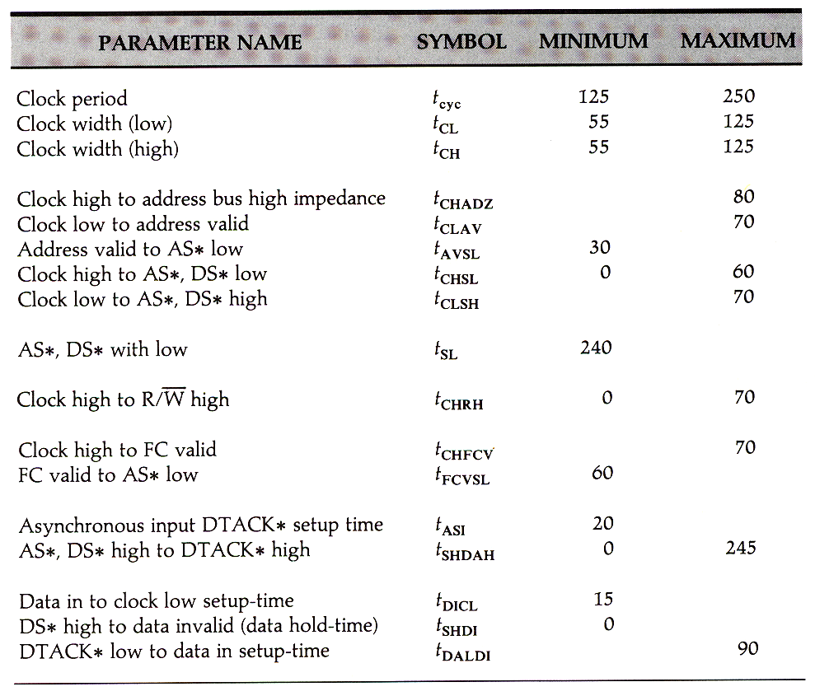
Original 68k Read Cycle Timings Taken From Data Sheet
Note: Times quoted here are for the original 68000 @ 8MHz

Slide 20
Timings for a 12.5MHz 68000

Slide 21
At 12.5MHz, Clock period t_{CYC} = 80ns
3 Clock periods = 240ns
Data latched internally by 68000 here at start of [S7]
Address becomes stable t_{CLAV} (55ns worst case) after the start of [S1]
68k min Data In Hold time t_{SHDI} relative to negation of LDS*/UDS* = 0ns
Access Time of any memory chip t_{AA} < (3 * t_{CYC}) – t_{CLAV –} t_{DICL} = 175 ns
Assuming CS* and OE* arrive in a timely fashion and do not delay data
min Data In Set-up time t_{DICL} at CPU prior to start of [S7] = 10ns

Slide 22
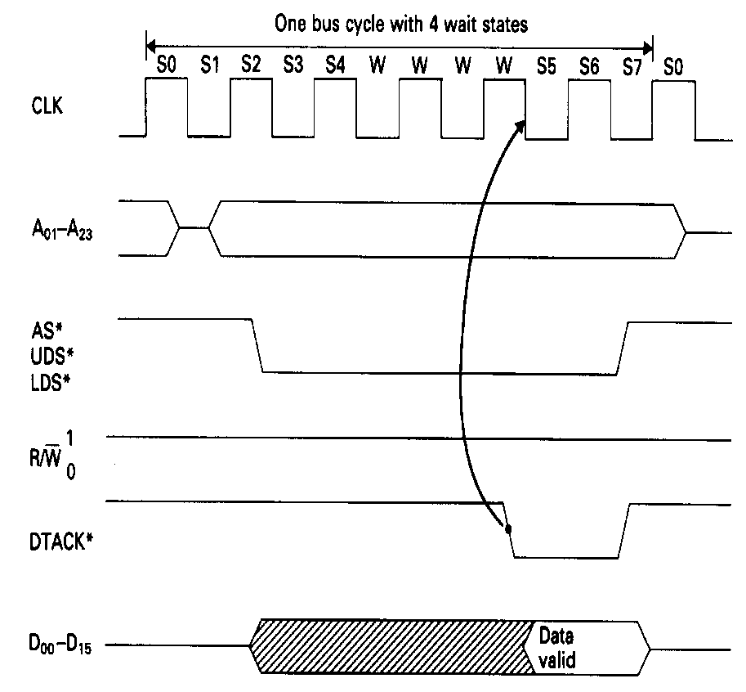
68k Asynchronous Bus Cycles with Wait States
Inserting Wait States
The 68k can extend a bus cycle indefinitely, to cater for slow memory systems that are not able to supply their data before start of state S7.
Description
If DTACK* is not asserted prior to the end of state S4, the 68000 will insert wait states into the bus cycle between states [S4] and [S5]. The timing diagram opposite illustrates this.
Note DTACK* signal is only sampled by the 68000 on the falling edge of the CLK, thus the minimum number of wait states that can be introduced is 2, i.e. 1 full clock cycle.
When a suitable number of wait states have been inserted and the slow memory has been given the appropriate extended time to respond it must then generate DTACK* to terminate the bus cycle.
In reality it is always the memory system logic,
rather than the memory chip itself, that supplies DTACK*.
Thus DTACK* is usually derived from some delay logic associated with a particular address map.
DTACK* only sampled on the falling edge of CLK therefore wait states come in multiples of 2

Slide 23
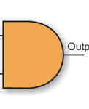
A Simple and Flexible 68k DTACK* Generator Circuit
There are many ways to make a DTACK* generator, but they all involve a timer that will generate DTACK* a pre-defined number of clock cycles after AS* becomes active.
For fast devices, DTACK* can be generated immediately. (we don’t have to wait until [S4])
For each speed of memory/IO device, a separate timer could be pre-loaded when AS* is high (in between 68k bus cycles) and allowed to count down to zero when enabled by the address decoder select signal (when AS* = 0) after which it produces a DTACK*
There are many possible solutions.
Fast Device Dtack
Generator Produces DTACK Immediately
Fast Sram CS*
&
Fast Rom CS*
Preloadable Timer Value
&
CPU DTACK*
AS*
Counter/Timers
Slow IO CS*
&
Load
2
Slow Dram CS*
Count Enable*
CPU Clock
Clock
Dtack_Out*
Slow Device Dtack
Generator after 2 clock
Loaded when AS* goes high, counts down when AS* is low

Slide 24
Asynchronous
SRam Write
Bus Cycle Timing

Slide 25
During a Write, Data has to be written to memory by the 68k
For a write to take place, the Data must be presented to the memory chip, at or before the memory chip’s WE and CE are be taken low. OE is ignored.
Memory chip address must remain valid throughout the write cycle.
IMPORTANT: Sram Write - Start and End of Write Conditions
An actual Sram write operation begins when its WE and CE lines are both driven low. The address must be valid at this point to avoid false writes to the wrong location.
The write operation ends and data is finally stored when either WE or CE is negated, (which ever comes first) at the Sram chip.
That is, whichever of the 68k signals AS, LDS/UDS or R/W goes high first, will serve to terminate the write cycle at the memory chip.

Slide 26
Address Setup and Hold times at memory during a write
There is also an address set up time at the memory chip to consider, given by the parameter t_{SA} as well as an address hold time t_{HA} after the write ends. We must check our design does not violate these two parameters.
We must also consider (and check) that the memory’s minimum write time, defined by the parameter t_{PWE} is not violated i.e. the minimum time for which WE and CE are both active to achieve an internal write.
Data Setup and Hold times at memory during a write
Finally there is a data set-up time t_{SD} and data hold time t_{HD} that must be met at the memory chip data pins associated with write termination. We must check our design does not violate these two parameters.
These are shown in the timing diagram on the next page.

Slide 27
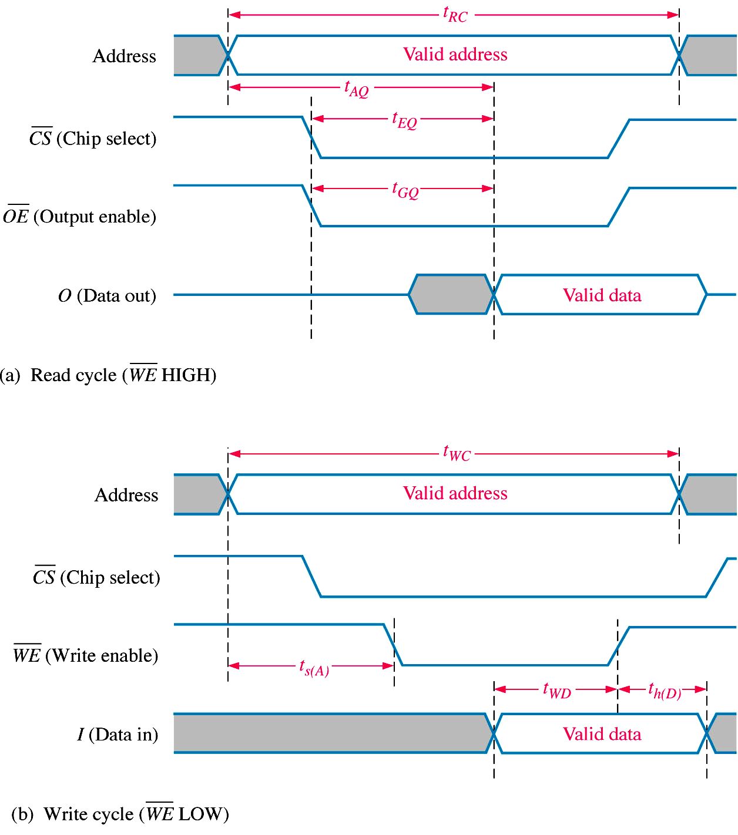
Typical Asynchronous Static Memory – Write Cycle Timing
Sram Write cycle time t_{WC} is the minimum time an address must be valid for a guaranteed write operation
Minimum Sram Address hold time t_{HA} following termination of write cycle (i.e. CE or WE negated)
Start
End
CE (Chip Enable)
t_{HA}
t_{PWE}
t_{SA}
t_{SD}
t_{HD}
Minimum Sram Write Pulse Width t_{PWE}
Minimum Address set up time at Sram t_{SA} must be met before start of a write
Sram Data in must meet minimum set-up t_{SD} and hold t_{HD} times at memory chip relative to end of a write

Slide 28
ISSI 256k x 16 Static Memory Timing Diagrams – Write Cycle
10ns
0ns
CE (Chip Enable)
10ns
0ns
LB/UB
t_{PWB} = 8ns
6ns
0ns
Min Timing Parameter Symbol ISSI 256k x 16
Write Cycle Time t_{WC} 10 ns (min)
Address Set-up Time t_{SA} 0 ns (min)
Address Hold Time t_{HA} 0 ns (min)
Data Set-up Time t_{SD} 6 ns (min)
Data Hold Time t_{HD} 0 ns (min)
Write Signal Pulse Width t_{PWE} 10 ns (min)
Byte Select to end of Write t_{PWB} 8 ns (min)

Slide 29
68000 Write
Bus Cycle Timing

Slide 30
Detailed 68000 Write Cycle Timing Diagram
The 68k’s write cycle timing is very similar to that of reading, except of course that the 68k is now driving data onto the data bus and into the memory chip.
There are two other minor differences:-
  R/W* is obviously low during a write cycle.
  UDS*/LDS* are asserted later in state S4 of a write bus cycle, (compared to a read bus cycle state where they are asserted in state S2), and removed at start of state S6. These two signals drive CE* on the memory chip to prevent the false writing of data to the wrong address.
Referring to the original circuit diagram (slide 3), the key signals here are UDS*/LDS* not R/W*. That is, the memory chip write cycle begins and ends with the assertion and negation of LDS*/UDS* rather than R/W*. Thus memory write timing analysis must be measured relative to LDS*/UDS*.
Let's check that the design on slide 3 does not violate any of the memory chips critical timings. We will use the ISSI chip on the DE2 board as an example.

Slide 31
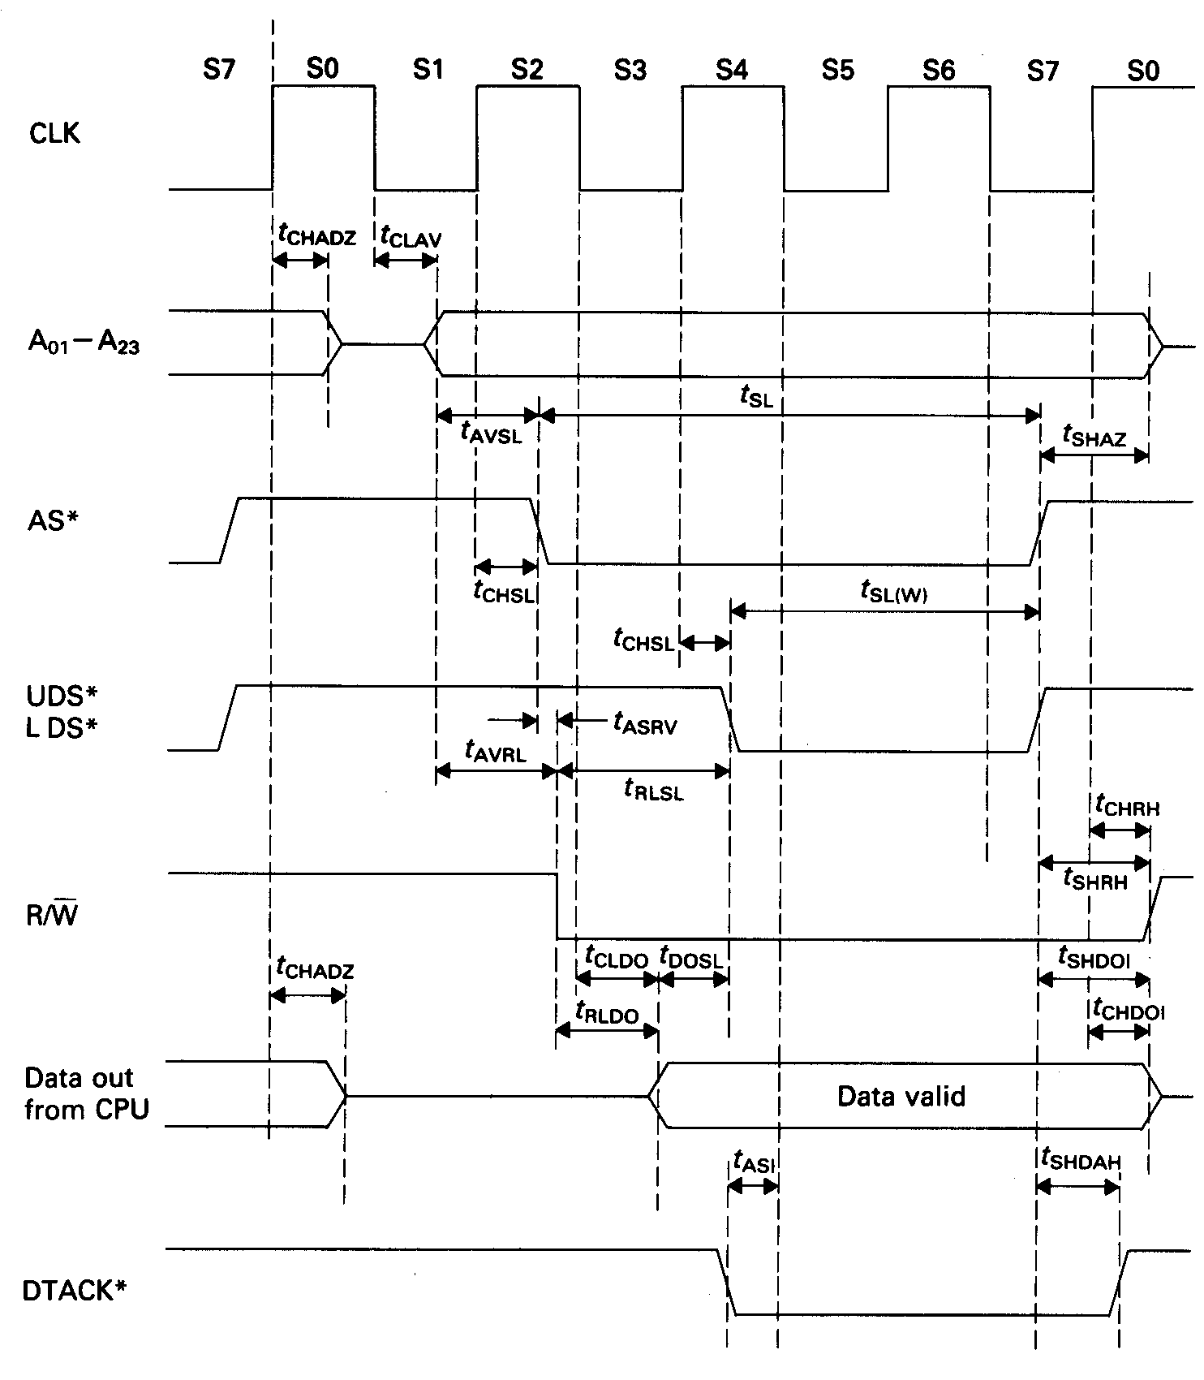
Detailed 68000 Write Cycle Timing Overlaid on ISSI Sram
68000 Signals
Sram Signals
Address Valid
A0-A17
Note LDS*/UDS* asserted later (S4) for a write cycle
LDS*/UDS* controls the memory CE* while AS* controls memory R/W*
Start
115ns
End
UDS*/LDS*
t_{PWE} > 10ns for ISSI
CE*, UB*/LB*
WE*
Data Valid
Data
Note: Times Quoted are for an 8MHz 68000 chip
Start of write when memory CE* and WE* both active
End of write when either CE* or WE* negated

Slide 32
Detailed 68000 Write Cycle Timing Overlaid on ISSI Sram
68k Signals
Address hold time relative to the end of write (LDS*/UDS*)
68000 = 30ns min, ISSI chip needs 0ns (timing met)
Sram Signals
Address Valid
A0-A17
30ns
Write
Start
Write
End
CE*, UB*/LB*
Address set-up time prior to start of write = 50+80 ns. ISSI needs 0ns (met)
50ns
80ns
R/W*
WE*
145 ns
30ns
Data Valid
Data
68k Write Data available 145ns before end of write.
ISSI data setup time = 6ns (timing met)
Data held valid by 68000 for 30ns min. ISSI needs 0ns (timing met)

Slide 33
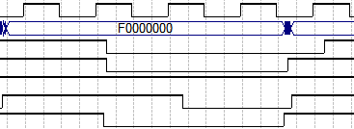
Quartus Write Cycle Simulation for Soft Core 68000
Quartus Simulation of the soft core 68k write cycle.
Note R/W* defined in S2 right through to S0 of next bus cycle.
UDS* (as this is for an 8 bit write) goes low in S4 and starts memory write operation (see circuit slide 3), but it is terminated by negation of AS* as that comes earlier.
S0
S1
S2
S3
S4
S5
S6
S7
S0
CLK
Address
R/W*
Start
End
AS*
LDS*
UDS*
Dtack*
Critical termination of Sram write when 68k’s AS*/UDS*/LDS* is negated.
What could happen if write was terminated only by R/W*?

Slide 34
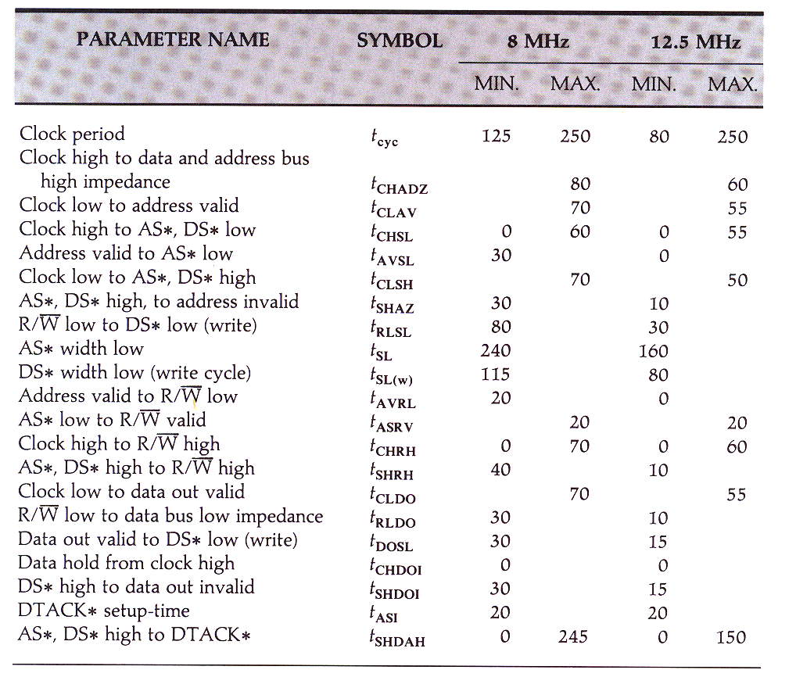
68000 Write Cycle Timings

Slide 35
What about Interfacing to
Synchronous Sram

Slide 36
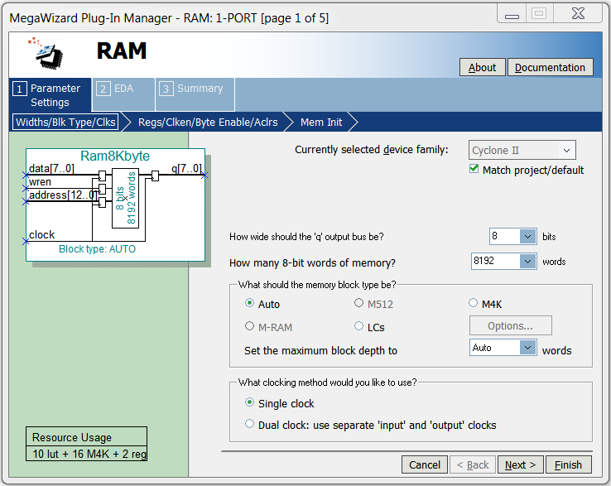
Remember from lecture 6 that Synchronous Sram (SSRam) has flip/flops to latch (or register) the SSRam input signals on a positive clock edge. The example below (taken from the Quartus Mega wizard) for FPGA synthesis, shows flips flops on the data (in), address and wren signals.
Optionally, it may also included flip flops on the data (q) outputs as well.
Bottom line is that the memory chip will only act on these signals on the next rising edge of the clock once the CPU has asserted the above signals.

Slide 37
68k READ Cycle Timing Analysis with FPGA Synchronous Sram
Assuming SSRam clock driven from CPU clock
AS* and LDS*/UDS* asserted here by 68k
Stable, Decoding can occur
Data sampled by 68k here at start of state S7
Worst case D_{out} delayed by 1 clock cycle if flip flops used
Data Available
SSRam stores Address and WE* signals on rising edge of clock so SSRam read can only commence here, on next rising clock edge, once AS* and LDS*/UDS* become asserted.
Available Read Access Time: = 60ns (i.e. 1.5 clock periods) if Sram and 68k both clocked at 25Mhz. The SSRam on the FPGA is MUCH faster than this

Slide 38
68k WRITE Cycle Timing Analysis with FPGA Synchronous Sram
Assuming SSRam clock driven from CPU clock
Address, DataOut, R/W*, AS* and LDS*/UDS* all asserted, at latest here, during a 68k write
Stable, Decoding can occur
Data out from 68k
Data Valid
Data write to memory thus starts here on next rising clock edge
Write ends here on next clock with removal of UDS*

Slide 39
Let’s look briefly at another processor
-
The LPC2926 – ARM 9 CPU with programmable external memory Timing

Slide 40
LPC2926 - Programmable External Rom/Ram Memory Controller
• Independent configuration programmability for up to 8 Banks of 16 MB each
• Programmable external data width: 8, 16 or 32 bits
• Programmable bus idle states (1 to 16) to avoid contention and “down time”
• Programmable read and write wait states (up to 32) per bank for fast or slow memory
• Programmable write protection
• Programmable burst-mode operation (for example with synchronous pipelined memory)
• Programmable burst-read wait states for burst-ROM devices
A₀ – A₂₃
‘24’ bit Wide Address Bus
Many of these features are easy to build into any microcomputer using a suitable state machine: e.g. They could be added to our 68k
D₀ – D₃₁
‘32’ bit wide Data Bus
32 bit internal Address Space
D₀ – D₃₁
BLS0
BLS1
Byte enable signals for 8, 16, 32 bit interface.
Similar to UDS/LDS on 68k
BLS2
BLS3
LPC2926
Arm 9 Core
WE
OE
3-Bit chip select bus: Decodes up to 8 Banks of 16MBytes
CS0 – CS2

Slide 41
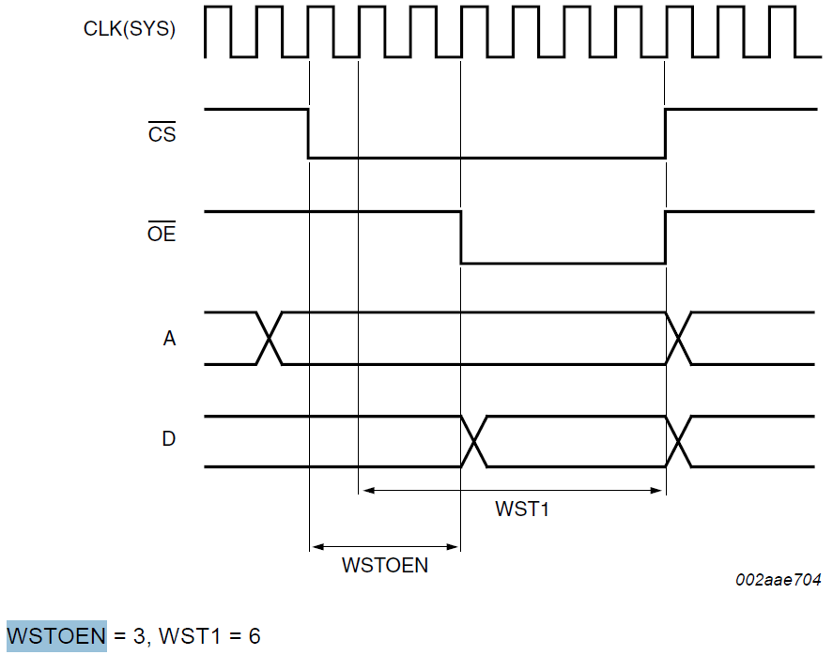
Read Cycle Timing
Unlike 68k, LPC2926 uses a synchronous bus interface with no Dtack. CPU outputs an address on rising edge and reads the data some programmed time later.
Memory Wait States and Output Enable delay all programmable to suit a particular memory device’s timing requirements. Here they are 6 and 3 clocks respectively
Note: Times quoted are for a 100MHz chip
At 100MHz, Clock period t_{CYC} = 10ns
7 Clock Periods = 70ns
OE delayed 3 clks
Address Setup time = ½ clock = 5ns
Address
Data
WST1 = 6
6 clock period wait state
Data Setup time back at CPU = 22ns
Access Time of the Memory Chip in this Example Timing: t_{AA} < (7 * t_{Cyc} ) + 5 - 22 = 53 ns

Slide 42
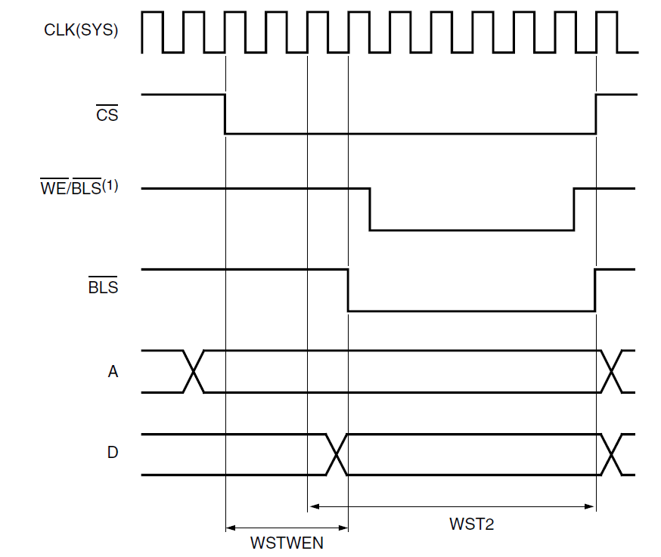
Write Cycle Timing
Memory write pulse width (Default write = 1 clock) and write enable wait states can also be programmed to suit a particular memory device’s timing requirements. Here they are 5 and 3 clocks respectively.
At 100MHz, Clock period t_{CYC} = 10ns
9 Clock Periods = 90ns
Note: Times quoted are for a 100MHz chip
WE pulse width: 5 clks
WE
WE delayed
3 clks
Address Setup time = 3½ clocks = 35ns
Address hold time = ½ clock = 5ns
Address
Data Setup time = 9 clocks = 90ns
Data hold time = ½ clock = 5ns
Data

Slide 43
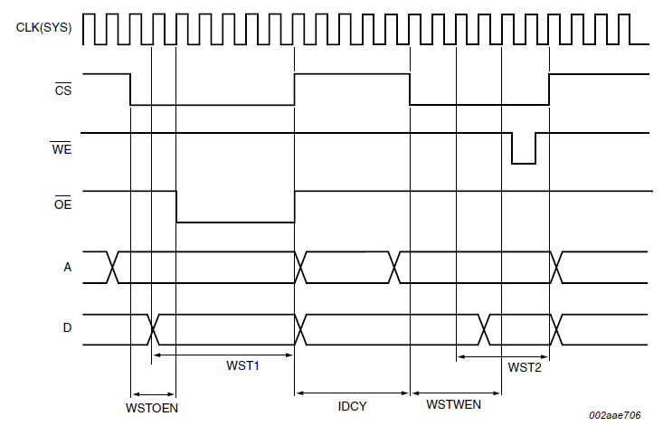
Idle Cycle Timing
Extra IDLE states can be programmed and inserted between a read and a write cycle to the same external memory device (forcing CS inactive - see IDCY below) to allow the device to recognize them as two separate operations, and to allow recovery between each.
With all these programmable bus cycle timings, we could now do exactly the same exercise that we did with the 68k. We could overlay the chosen memory chip timing on top of the CPU timing from the last 3 slides and check for any timing violations. Where necessary we can reprogram the CPU with new bus cycle timing to suite.
Read Cycle
Idle
Write Cycle
5 Clks

